Slide 1




Noida Institute of Engineering and Technology, Greater Noida
Faculty Introduction
Dr. P P Giri
M.Sc.M.Phil,PhD
Professor
Department of Chemistry

Slide 2
Noida Institute of Engineering and Technology, Greater Noida
Subject /Course Details
Subject /Course Name
Environmental science
Subject /Course Code
ANC0302 / ANC0402
Year –II
Semester –III/IV

Slide 3
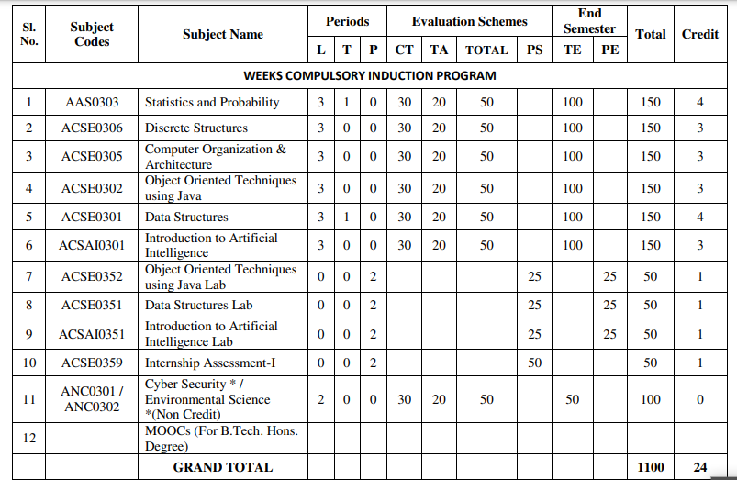
Evaluation Scheme

Slide 4
Syllabus
UNIT-I (Basic Principle of ecology)
Definition, Scope and basic principles of ecology and environment. Ecosystem: Basic concepts, components of ecosystem.
Food chains and food webs. Ecological pyramids, Energy flow in ecological systems, Characteristics of different ecosystems.
Biogeochemical Cycles: Importance, gaseous and sedimentary cycles. Carbon, Nitrogen, Phosphorus and Sulphur Cycles.
Basic concepts of sustainable development, SDGs, Ecosystem services, UN Decade for Eco restoration.

Slide 5
Syllabus
UNIT-II (Natural Resources and Associated Problems)
Natural resources and associated problems.
Forest resources: Use and over-exploitation, deforestation. Timber extraction, mining, dams and their effects on forest and tribal people.
Mineral resources: Use and exploitation, environmental effects of extracting and using mineral resources.
Food resources: World food problems, changes caused by agriculture and over-grazing, effects of modern agriculture, fertilizer-pesticide problems, water logging, salinity.
Land resources: Land as a resource, land degradation, man induced landslides. Equitable use of resources for sustainable lifestyles.
Non Renewable Energy Resources: Fossil fuels and their reserves, Nuclear energy, types, uses and effects,
Renewable Energy Resources: Hydropower, Solar energy, geothermal, tidal and wind energy, Biomass energy, biogas and its advantages.

Slide 6
Syllabus
UNIT-III (Biodiversity Succession)
Biodiversity and their importance, Threats to biodiversity, major causes, extinction’s, vulnerability of species to extinction, IUCN threat categories, Red data book.
Strategies for biodiversity conservation, principles of biodiversity conservation in-situ and ex-situ conservation strategies,Mega diversity zones and Hot spots, concepts, distribution and importance.
Succession: Concepts of succession, Types of Succession. Trends in succession. Climax and stability.

Slide 7
Syllabus
UNIT-IV (Pollution and Solid Waste Management)
Air pollution: sources of air pollution, Primary and secondary air pollutants. Origin and effects of SO_{X}, NO_{X}, CO_{X}, CFC’s, Hydrocarbon,, control of air pollution.
Water pollution: sources and types of water pollution, Effects of water pollution, Eutrophication,
Soil pollution: Causes of soil pollution, Effects of soil pollution
Noise Pollution: Major sources of and effects of noise pollution on health,
Radioactive and thermal pollution: sources and their effects on surrounding environment.
Solid waste disposal and its effects on surrounding environment
Climate change, global warming, acid rain, ozone layer depletion,

Slide 8
Syllabus
UNIT-V (Role of Community and Environmental Protection Acts)
Role of community, women and NGOs in environmental protection, Bioindicators and their role, Natural hazards, Chemical accidents and disasters risk management,
Environmental Impact Assessment (EIA)
Salient features of following Acts:
a. Environmental Protection Act, 1986, Wildlife (Protection) Act, 1972.
b. Water (Prevention and control of pollution) Act, 1974.
c. Air (Prevention and control of pollution) Act, 1981. Forest (Conservation) Act, 1980.
d. Wetlands (Conservation and Management) Rules, 2017;
e. Chemical safety and Disaster Management law.
f. District Environmental Action Plan. Climate action plans.

Slide 9
Applications for Emerging Technology
Environmental engineering is the application of science and engineering principles to improve the environment (air, water, and/or land resources), to provide healthful water, air, and land for human habitation and for other organisms, and to remediate polluted sites.

Slide 10
Course Objectives(CO1)
To help the students in realizing the inter-relationship between man and environment and help the students in acquiring basic knowledge about environment.
To develop the sense of awareness among the students about environment and its various problems.
To create positive attitude about environment among the student.
To develop proper skill required for the fulfillment of the aims of environmental education and educational evaluations
To develop the capability of using skills to fulfill the required aims, to realize and solve environmental problems through social, political, cultural and educational processes

Slide 11
Course Outcome
CO 1 | Understand the basic principles of ecology and environment. Ecosystem: Basic concepts, components of ecosystem, food chains and food webs. Ecological pyramids | K1,K2
CO 2 | Understand the different types of natural recourses like food, forest, Minerals and energy and their conservation | K1.K2
CO 3 | Understand the importance of biodiversity, Threats of biodiversity and different methods of biodiversity conservation. | K1,K2
CO 4 | Understand the different types of pollution, pollutants, their sources, effects and their control methods. | K1,K2,K3
CO 5 | Understand the basic concepts of sustainable development, Environmental Impact Assessment (EIA) and different acts related to environment | K1,K2,K3

Slide 12

Topic mapping with CO
Topic | Topic outcome | CO Map | Extend of mapping
Environment and its segment | Students understand the meaning of environment | CO1 | 1
Segment of atmosphere Multidisciplinary nature of EVS Scope and importance of evs | .Students understand different segment of atmosphere Students understand the basic knowledge of basic science Students understand the scope of environmental SC. | CO1 | 1
Food chain and food web | Students understand the definition and types of food chain | CO1 | 2
Ecological pyramid | Students understand the graphical representation of food chain | CO1 | 1
Ecosystem and its types | Students understand the interaction between the biotic and abiotic Components .along its types | CO1 | 1
Components of ecosystem | Students understand the living and non living components | CO1 | 1
Function of ecosystem | Students understand the functions of ecosystems. | CO1 | 2
Forest recourses | Students understand the functions and value of forest | CO1 | 1
Deforestation | Students understand the ill effect and causes of deforestation | CO1 | 1
Mining and transportation activity. | Students understand the ill effects of mining and transportation activity | CO1 | 1
Notes:
Shubhi and Jyoti

Slide 13
Program Outcome (PO’s)
Engineering Knowledge,
Problem Analysis
Design/development of solutions,
Conduct investigations of complex Problems,
Modern tool usage,
The engineer and society,
Environment and sustainability,
Ethics,
Individual and team work,
Communication,
Project management and finance,
Life-long learning

Slide 14
CO-PO Mapping
CO | PO-1 | PO-2 | PO-3 | PO-4 | PO-5 | PO-6 | PO-7 | PO-8 | PO-9 | PO-10 | PO-11 | PO-12
CO1 | 2 | 2 | 1 | 1 | - | 2 | 3 | 2 | 2 | 2 | - | 2
CO2 | 2 | 2 | 1 | 1 | - | 2 | 3 | 2 | 2 | 2 | - | 2
CO3 | 2 | 2 | 1 | 1 | - | 2 | 3 | 2 | 2 | 2 | - | 2
CO4 | 2 | 2 | 1 | 1 | - | 2 | 3 | 2 | 2 | 2 | - | 2
CO5 | 2 | 2 | 1 | 1 | - | 2 | 3 | 2 | 2 | 2 | - | 2
Mean | 2 | 2 | 1 | - | - | 1 | 3 | 2 | 2 | 2 | - | 2

Slide 15
Program Specific Outcome (PSO’s)
Not applicable

Slide 16
COs and PSOs Mapping
Not applicable

Slide 17
Program Educational Objectives (PEOs)
Not applicable

Slide 18
Result Analysis
Not Available (first time included)

Slide 19
End Semester Question Paper Templates

Slide 20
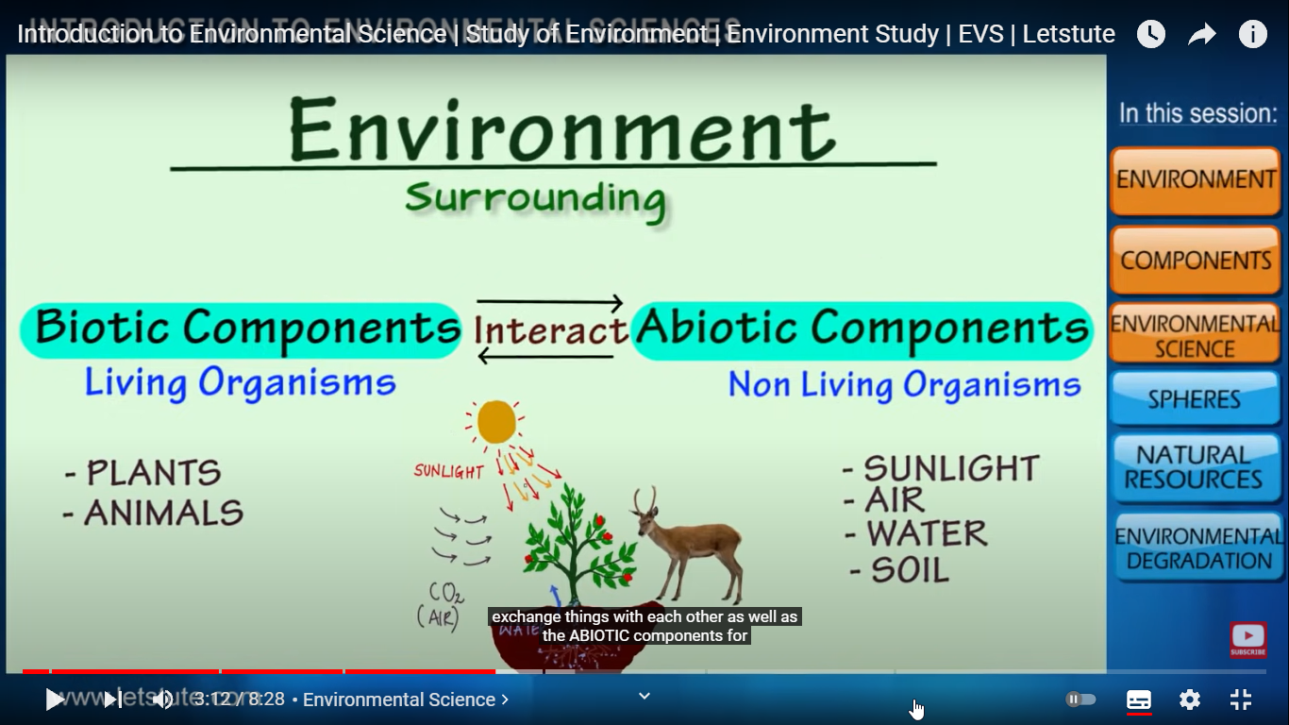
Brief Introduction about the Subject
Environmental studies are the study of human interaction with the environment and in the interests of solving complex problems.
Environment includes which we are directly or indirectly dependent for our survival, whether it is living component like animals, plants or non living component like soil, air and water.
The biologist Jacob Van Uerkal (1864-1944) introduced the term ‘environment’
Video: https://www.youtube.com/watch?v=7G3eXI_DPn8

Slide 21
Noida Institute of Engineering and Technology, Greater Noida
Unit: II
UNIT-II (Natural Resources and Associated Problems)
Natural resources and associated problems.
Forest resources: Use and over-exploitation, deforestation. Timber extraction, mining, dams and their effects on forest and tribal people.
Mineral resources: Use and exploitation, environmental effects of extracting and using mineral resources.
Food resources: World food problems, changes caused by agriculture and over-grazing, effects of modern agriculture, fertilizer-pesticide problems, water logging, salinity.
Land resources: Land as a resource, land degradation, man induced landslides. Equitable use of resources for sustainable lifestyles.
Non Renewable Energy Resources: Fossil fuels and their reserves, Nuclear energy, types, uses and effects,
Renewable Energy Resources: hydropower, Solar energy, geothermal, tidal and wind energy, Biomass energy, biogas and its advantages.

Slide 22
Content
Forest resources:
Use and over-exploitation,
Deforestation.
Timber extraction, mining, dams and
Their effects on forest and tribal people.
Mineral resources:
Use and exploitation,
Environmental effects of extracting and using mineral resources.
Food resources:
World food problems,
Changes caused by agriculture and over-grazing,
Effects of modern agriculture, fertilizer-pesticide problems, water logging, salinity.
Land resources:
Land as a resource, land degradation, man induced landslides.
Equitable use of resources for sustainable lifestyles.
Non Renewable Energy Resources:
Fossil fuels and their reserves,
Nuclear energy, types, uses and effects,

Slide 23
Content
Renewable Energy Resources:
Hydropower,
Solar energy,
Geothermal,
Tidal
Wind energy,
Biomass energy, biogas and its advantages.

Slide 24
Prerequisite and Recap
Basic knowledge of nature

Slide 25
Course Objective(CO2)
To develop the sense of awareness among the students about environment and its various problems.

Slide 26
Natural Resources(CO2.)
Natural Resources
Any material which can be transformed in a way that it becomes more valuable and useful can be termed as resource.
In other words, it is possible to obtain valuable items from any resources.
Life on this planet depends upon a large number of things and services provided by the nature, which are known as Natural Resources.
These are water, air, soil, minerals, coal, forests, crops and wild life are all examples of natural resources.
Natural resources can be defined as the resources that exist (on the planet) independent of human actions.
These are the resources that are found in the environment and are developed without the intervention of humans.
Common examples of natural resources include air, sunlight, water, soil, stone, plants, animals and fossil fuels.
Natural resources are naturally occurring materials that are useful to man or could be useful under conceivable technological, economic or social circumstances or supplies drawn from the earth, supplies such as food, building and clothing materials, fertilizers, metals, water and geothermal power.

Slide 27
Natural Resources(CO2.)
Types of Natural Resources
Based on the availability are two types of natural resources:
Renewable:
Resources that are available in infinite quantity and can be used repeatedly are called renewable resources.
Example: Forest, wind, water, etc.
Non-Renewable:
Resources that are limited in abundance due to their non-renewable nature and whose availability may run out in the future are called non-renewable resources.
Examples include fossil fuels, minerals, etc.
Renewable resource | Non-renewable resource
It can be renewed as it is available in infinite quantity | Once completely consumed, it cannot be renewed due to limited stock
Sustainable in nature | Exhaustible in nature
Low cost and environment-friendly | High cost and less environment-friendly
Replenish quickly | Replenish slowly or do not replenish naturally at all

Slide 28
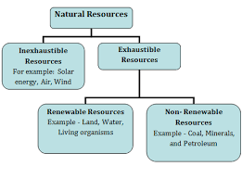
Natural Resources(CO2.)
On the basis of origin, natural resources may be divided into two types:
Biotic — Biotic resources are obtained from the biosphere (living and organic material), such as forests and animals, and the materials that can be obtained from them.
Fossil fuels such as coal and petroleum are also included in this category because they are formed from decayed organic matter.
Abiotic – Abiotic resources are those that come from non-living, non-organic material.
Examples of abiotic resources include land, fresh water, air, rare-earth elements, and heavy metals including ores, such as gold, iron, copper, silver, etc.

Slide 29
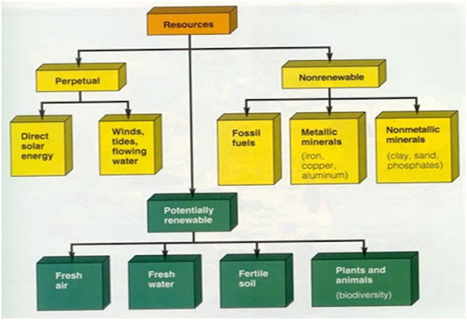
Natural Resources(CO2.)

Slide 30
Natural Resources(CO2.)
Problems associated with natural resources
1. The unequal consumption of natural resources
2. Planning land use
3. The need for sustainable lifestyles
The unequal consumption of natural resources
A major part of natural resources today are consumed in the technologically advanced or ‘developed’ world, usually termed ‘the west’.
The ‘developing nations’ of ‘the east’, including India and China, also over use many resources because of their greater human population.
However, the consumption of resources per capita (per individual) of the developed countries is up to 50 times greater than in most developing countries.
Advanced countries produce over 75% of global industrial waste and greenhouse gases.

Slide 31
Natural Resources(CO2.)
Planning land use
Land is a major resource, needed for not only for food production and animal husbandry, but also for industry and growing human settlements.
These forms of intensive land use are frequently extended at the cost of ‘wild lands’, our remaining forests, grasslands, wetlands and deserts.
This demands for a pragmatic policy that analyses the land allocation for different uses. The need for sustainable lifestyles
Human standard of living and the health of the ecosystem are indicators of sustainable use of resources in any country or region. Ironically, both are not in concurrence with each other.
Increasing the level of one, usually leads to degradation of other.
Development policies should be formulated to strike a balance between the two.

Slide 32
Forest Resources(CO2.)
Forest Resources :
It is an important natural resource.
It is most important natural habitat for wild life.
It is also utilized by farmers for commercial and recreational purposes.
Many herbivores find shelter and carnivores their prey in the forest.
It is important renewable resources.
Forest vary in composition and diversity and can contribute substantially to the economic development of any country .
Plants along with trees cover large areas, produce variety of products and provide food for living organisms, and also important to save the environment.
It is estimated that about 30% of world area is covered by forest whereas 26% by pastures.
Among all continents, Africa has largest forested area (33%) followed by Latin America (25%), whereas in North America forest cover is only 11%. Asia and former USSR has 14% area under forest.

Slide 33
Forest Resources(CO2.)
European countries have only 3% area under forest cover. India’s Forest Cover accounts for 20.6% of the total geographical area of the country as of 2005.
Besides this, forest plays most important role from commercial point of view.
Forest based cottage industries, such as bee-keeping, bamboo mat and basket making provides small-scale industry to the tribal people.
Sal is a most important source for timber industries.
It also provides raw materials for pulp and plywood industry.
Green plants of the forest are food-producing organisms and are primary producers of the 'food chain’.
These foods are stored in the form of fruits, nuts, seeds, nectar and wood.
http://ecoursesonline.iasri.res.in/mod/page/view.php?id=89582

Slide 34
Forest Resources(CO2.)
Significance of forests Forest can provide prosperity of human being and to the nations. Important uses of forest can be classified as under
Commercial values
Ecological significance
Aesthetic values
Life and economy of tribal
Commercialvalues
Forests are main source of many commercial products such as wood, timber, pulpwood etc.
About 1.5 billion people depend upon fuel wood as an energy source. Timber obtained from the forest can used to make plywood, board, doors and windows, furniture, and agriculture implements and sports goods.
Timber is also a raw material for preparation of paper, rayon and film.
Forest can provide food , fibre, edible oils and drugs.
Forest lands are also used for agriculture and grazing.
Forest is important source of development of dams, recreation and mining.

Slide 35
Forest Resources(CO2.)
Life and economy of tribal
Forest provide food, medicine and other products needed for tribal people and play a vital role in the life and economy of tribes living in the forest.
Ecological uses
Forests are habitat to all wild animals, plants and support millions of species.
They help in reducing global warming caused by green house gases and produces oxygen upon photosynthesis.
Forest can act as pollution purifier by absorbing toxic gases.
Forest not only helps in soil conservation but also helps to regulate the hydrological cycle.
Aesthetic values
All over the world people appreciate the beauty and tranquility of the forest because forests have a greatest aesthetic value.
Forest provides opportunity for recreation and ecosystem research.

Slide 36
Forest Resources(CO2.)
Over exploitation of forests
Forests contribute substantially to the national economy.
With increasing population increased demand of fuel wood, expansion of area under urban development and industries has lead to over exploitation of forest .
At present international level we are losing forest at the rate of 1.7 crore hectares annually.
Overexploitation also occurs due to overgrazing and conversion of forest to pastures for domestic use.
Deforestation
Forest are burned or cut for clearing of land for agriculture ,harvesting for wood and timber , development and expansion of cities .
These economic gains are short term where as long term effects of deforestation are irreversible
Deforestation rate is relatively low in temperate countries than in tropics.
If present rate of deforestation continues we may losses 90% tropical forest in coming six decades
For ecological balance 33% area should be under forest cover but our nation has only 20.6% forest cover.

Slide 37
Forest Resources(CO2.)
Causes of deforestation
Forest area in some developed area has expanded.
However in developing countries area under forest is showing declining trend particularly in tropical region.
Main causes of deforestation are
a) Shifting cultivation or jhum cultivation
b) Commercial logging
c) Need for fuel wood
d) Expansion for agribusiness
e) Development projects and growing need for food
f) Raw materials for industrial use

Slide 38
Forest Resources(CO2.)
Shifting cultivation or jhum cultivation
This practice is prevalent in tribal areas where forest lands are cleared to grow subsistence crops.
It is estimated that principle cause of deforestation in tropics in Africa, Asia and tropical America is estimated to be 70, 50, and 35% respectively.
Shifting cultivation which is a practice of slash and burn agriculture are posses to clear more than 5 lakh hectares of land annually.
In India, shifting cultivation is prevalent in northeast and to limited extent in M.P, Bihar and Andhra Pradesh and is contributing significantly to deforestation.
Commercial logging
It is a important deforestation agent.
It may not be the primary cause but definitely it acts as secondary cause, because new logging lots permits shifting cultivation and fuel wood gatherers access to new logged areas.
Need for fuel wood
Increased population has lead to increasing demand for fuel wood which is also acting as an important deforestation agent, particularly in dry forest.

Slide 39
Forest Resources(CO2.)
Expansion for agribusiness
With the addition of cash crops such as oil palm, rubber, fruits and ornamental plants, there is stress to expand the area for agribusiness products which results in deforestation.
Development projects and growing need for food
The growing demand for electricity, irrigation, construction, mining, etc. has lead to destruction of forest.
Increased population needs more food which has compelled for increasing area under agriculture crops compelling for deforestation.
Raw materials for industrial use
Forest provides raw material for industry and it has exerted tremendous pressure on forest.
Increasing demand for plywood for backing has exerted pressure on cutting of other species such as fir to be used as backing material for apple in J&K and tea in northeast states.

Slide 40
Forest Resources(CO2.)
Major effects of deforestation Deforestation adversely and directly affects and damages the environment and living beings .
Major causes of deforestation are
Soil erosion and loss of soil fertility
Decrease of rain fall due to affect of hydrological cycle
Expansion of deserts
Climate change and depletion of water table
Loss of biodiversity ,flora and fauna
Environmental changes and disturbance in forest ecosystems

Slide 41
Forest Resources(CO2.)
Case studies: Jhum cultivation
Chipko movement
Western himalayan region Jhum cultivation
Jhum Agriculture or shifting agriculture has destroyed large number of hectare of forest tracts in North-Eastern states and Orissa.
Jhum agriculture is subsidence agriculture in which tract of forest land is cleared by cutting trees and it is used for cultivation.
After few years, when productivity of the land decreases, cultivators abandon the land and clear next tract.
As a result of this practise, combined with increasing population there is rapid deforestation as more and more cultivators clear forest to cultivate land.
Also, with increase in population there is cultivators are forced to return to previous tracts of land in relatively shorter durations, not allowing the land to regain its productivity.

Slide 42
Forest Resources(CO2.)
Chipko movement
The Chipko movement or Chipko Andolan is a social-ecological movement that practised the Gandhian methods of satyagraha and non-violent resistance, through the act of hugging trees to protect them from being felled.
The modern Chipko movement started in the early 1970s in the Garhwal Himalayas of Uttarakhand,with growing awareness towards rapid deforestation.
The landmark event in this struggle took place on March 26, 1974, when a group of peasant women in Reni village, Hemwalghati, in Chamoli district, Uttarakhand, India, acted to prevent the cutting of trees and reclaim their traditional forest rights that were threatened by the contractor system of the state Forest Department.
Their actions inspired hundreds of such actions at the grassroots level throughout the region.
By the 1980s the movement had spread throughout India and led to formulation of people-sensitive forest policies, which put a stop to the open felling of trees in regions as far reaching as Vindhyas and the Western Ghats.

Slide 43
Forest Resources(CO2.)
Western himalayan region.
Over the last decade, there has been widespread destruction and degradation of forest resources in Himalayas, especially Western Himalayas.
This has resulted in various problems such as erosion of top soil, irregular rainfall, changing weather patterns and floods.
Construction of roads on hilly slopes, have not only undermined their stability, but also damaged protective vegetation and forest cover.
Tribes in these areas are increasingly facing shortage of firewood and timber, due large scale tree cutting.
Increased traffic volumes on these roads leads to increased pollution in the area.

Slide 44
Forest Resources(CO2.)
Timber extraction
There has been unlimited exploitation of timber for commercial use.
Due to increased industrial demand; timber extraction has significant effect on forest and
tribal people. Logging
Poor logging results in degraded forest and may lead to soil erosion especially on slopes.
New logging roads permit shifting cultivators and fuel wood gatherers to gain access to the logging area.
Loss of long term forest productivity
Species of plants and animals may be eliminated
Exploitation of tribal people by contractor.

Slide 45
Forest Resources(CO2.)
Mining
It is the extraction of valuable minerals or other geological materials from the Earth, usually from an ore body, lode, vein, seam, reef, or placer deposit.
These deposits form a mineralized commodity that is of economic interest to the miner.
Mining operations usually create a negative environmental impact, both during the mining activity and after the mine has closed. Major effects of mining operations on forest and tribal people are:
Mining from shallow deposits is done by surface mining while that from deep deposits is done by sub-surface mining.
It leads to degradation of lands and loss of top soil.
It is estimated that about eighty thousands hectare land is under stress of mining activities in India
Mining leads to drying up perennial sources of water sources like spring and streams in mountainous area.
Mining and other associated activities remove vegetation along with underlying soil mantle, which results in destruction of topography and landscape in the area.
Large scale deforestation has been reported in Mussorie and Dehradun valley due to indiscriminating mining.

Slide 46
Forest Resources(CO2.)
The forested area has declined at an average rate of 33% and the increase in non-forest area due to mining activities has resulted in relatively unstable zones leading to landslides.
Indiscriminate mining in forests of Goa since 1961 has destroyed more than 50000 ha of forest land.
Coal mining in Jharia, Raniganj and Singrauli areas has caused extensive deforestation in Jharkhand.
Mining of magnetite and soapstone have destroyed 14 ha of forest in hilly slopes of Khirakot, Kosi valley and Almora.
Mining of radioactive minerals in Kerala, Tamilnadu and Karnataka are posing similar threats of deforestation.
The rich forests of Western Ghats are also facing the same threat due to mining projects for excavation of copper, chromites, bauxite and magnetite.
http://ecoursesonline.iasri.res.in/mod/page/view.php?id=4527

Slide 47
Forest Resources(CO2.)
Effects of dams on forests and tribal people
Pandit Jawaharlal Nehru referred dam and valley projects as “Temples of modern India”.
These big dams and rivers valley projects have multi-purpose uses. However, these dams are also responsible for the destruction of forests.
They are responsible for degradation of catchment areas, loss of flora and fauna, increase of water borne diseases, disturbance in forest ecosystems, rehabilitation and resettlement of tribal peoples.
India has more than 1550 large dams, the maximum being in the state of Maharashtra (more than 600), followed by Gujarat (more than 250) and Madhya Pradesh (130).
The highest one is Tehri dam, on river Bhagirathi in Uttaranchal and the largest in terms of capacity is Bhakra dam on river Satluj in Himachal Pradesh.
Big dams have been in sharp focus of various environmental groups all over the world, which is mainly because of several ecological problems including deforestation and socio-economic problems related to tribal or native people associated with them.

Slide 48
Forest Resources(CO2.)
The Silent valley hydroelectric project was one of the first such projects situated in the tropical rain forest area of Western Ghats which attracted much concern of the people.
The crusade against the ecological damage and deforestation caused due to Tehri dam was led by Shri. Sunder Lal Bahaguna, the leader of Chipko Movement.
The cause of Sardar Sarovar Dam related issues have been taken up by the environmental activitist Medha Patkar, joined by Arundhati Ray and Baba Amte.
For building big dams, large scale devastation of forests takes place which breaks the natural ecological balance of the region.
Floods, droughts and landslides become more prevalent in such areas.
Forests are the repositories of invaluable gifts of nature in the form of biodiversity and by destroying them (particularly, the tropical rain forests), we are going to lose these species even before knowing them.
These species could be having marvellous economic or medicinal value and deforestation results in loss of this storehouse of species which have evolved over millions of years in a single stroke.

Slide 49
Forest Resources(CO2.)
Forest conservation and management Forest is one of the most valuable resources and thus needs to be conserved. To conserve forest, following steps should be taken.
Conservation of forest is a national problem, thus it should be tackled with perfect coordination between concerned government departments.
People should be made aware of importance of forest and involved in forest conservation activities.
The cutting of trees in the forests for timber should be stopped.
A forestation programmes should be launched
Grasslands should be regenerated.
Forest conservation Act should be strictly implemented to check deforestation.
Awards should be instituted for the deserving.

Slide 50
Mineral Resources(CO2.)
Mineral Resources
A mineral is a naturally occurring substance, representable by a chemical formula, that is usually solid and inorganic, and has a crystal structure.
Mineral resources are the key material basis for socio-economic development.
Statistical results show that more than 95% of energy used by mankind, 80% industrial raw materials and 70% raw materials for agricultural production are from mineral resources.
Minerals are essential for the formation and functioning of organisms, plant animals and human beings.
In the modern era, human life needs variety of minerals to sustain industry based civilization.
Mineral resources are broadly defined as elements, chemical compounds, and mixtures which are extracted to manufacture sustainable commodity.
India has rich mineral resource base to provide suitable base for industrial development in the country.

Slide 51
Mineral Resources(CO2.)
India’s reserves, as well as production are adequate in petroleum, ores of copper, lead, zinc, tin, graphite, mercury, tungsten, and in the minerals required for fertilizer industry such as sulphur, potassium and phosphorus.
Exploitation of Minerals
Depending on their use, mineral resources can be divided into several broad categories such as elements for metal production and technology, building materials, minerals for the chemical industry and minerals for agriculture.
When usually we think about mineral resources we often think of metals but the predominant mineral resources are not metallic.
Sodium and iron are used at a rate of about 0.1 to 1.0 billion metric tons per year.
Nitrogen, sulphur, potassium and calcium are primarily used as fertilizers at a rate of about 10 to 100 million metric tons per year.
http://ecoursesonline.iasri.res.in/mod/page/view.php?id=4531

Slide 52
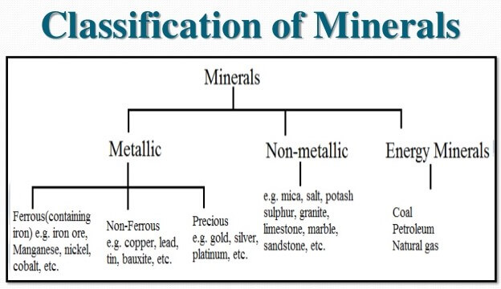
Mineral Resources(CO2.)
Zinc, copper, aluminium and lead are used at a rate of about 3 to 10 million metric tons per year;
Gold and silver are used at a rate of about 10 thousand metric tons per year.
Out of all the metallic minerals, iron consumption is 95% of the metals consumed
Thus, with the exception of iron, the non-metallic minerals are consumed at much greater rates than the elements used for their metallic properties

Slide 53
Mineral Resources(CO2.)
Uses of Minerals
Due to increased population, there is increased demand of minerals by the industry, transport, agriculture and defence preparation.
Depletion of almost all known and easily accessible deposits is anticipated in near future.
Moreover, there may be shortage of some crucial elements such as mercury, tin, copper, gold, silver and platinum.
The limited resource of phosphorus, which is an essential component of chemical fertilizers, is another area of concern
Environmental Impacts of Mineral Extraction
Extracting and use of mineral resources can affect the environment adversely.
Environmental affect may depend on factors such as mining procedures, ore quality, climate, size of operation, topography, etc.
Some of major environmental impacts of mining and processing operations are as under

Slide 54
Mineral Resources(CO2.)
1. Degradation of land.
2. Pollution of surfaces and ground water resources.
3. Effect on growth of vegetation due to leaching out effect of minerals.
4. Surface water pollution and groundwater contamination lead to occupational health hazards etc.
5. Air pollution due to emission of gases.
6. Deforestation affects flora and fauna.
7. Rehabilitation of affected population

Slide 55
Mineral Resources(CO2.)
Conservation of Minerals
Conservation of minerals can be done in number of ways and these are as follows,
Industries can reduce waste by using more efficient mining and processing methods.
In some cases, industries can substitute plentiful materials for scarce ones.
Some mineral products can be recycled. Aluminum cans are commonly recycled. Although bauxite is plentiful, it can be expensive to refine. Recycling aluminum products does not require the large amounts of electric power needed to refine bauxite.
Products made from many other minerals, such as nickel, chromium, lead, copper, and zinc, can also be recycled.
Strict laws should be made and enforced to ensure efficient management of mining resources.

Slide 56
Mineral Resources(CO2.)
Case Study
Ara villi mountains which covers about 10% of geographical area is rich source of minerals wealth .
This mountain range play important role in control of climate and act as mini water shed. On the request of environmentalist, Honourable Supreme Court has passed the order to stop these mines in Rajasthan
Marble mining near Rajsamant Lake has lead to drying up of lake. Marble mining was stopped on December 2002.
Recently, mining in Goa has attained the attention of the press and media and ultimately government has to take the decision to stop this mining.

Slide 57
Food Resources(CO2.)
Food
It is essential for growth and development of living organisms.
These essential materials are called nutrients and these nutrients are available from variety of animals and plants.
There are thousands of edible plants and animals over the world, out of which only about three dozen types constitute major food of humans.
Food sources
The majority of people obtain food from cultivated plants and domesticated animals.
Although some food is obtained from oceans and fresh waters, but the great majority of food for human population is obtained from traditional land-based agriculture of crops and livestock.
.http://ecoursesonline.iasri.res.in/mod/page/view.php?id=4533

Slide 58
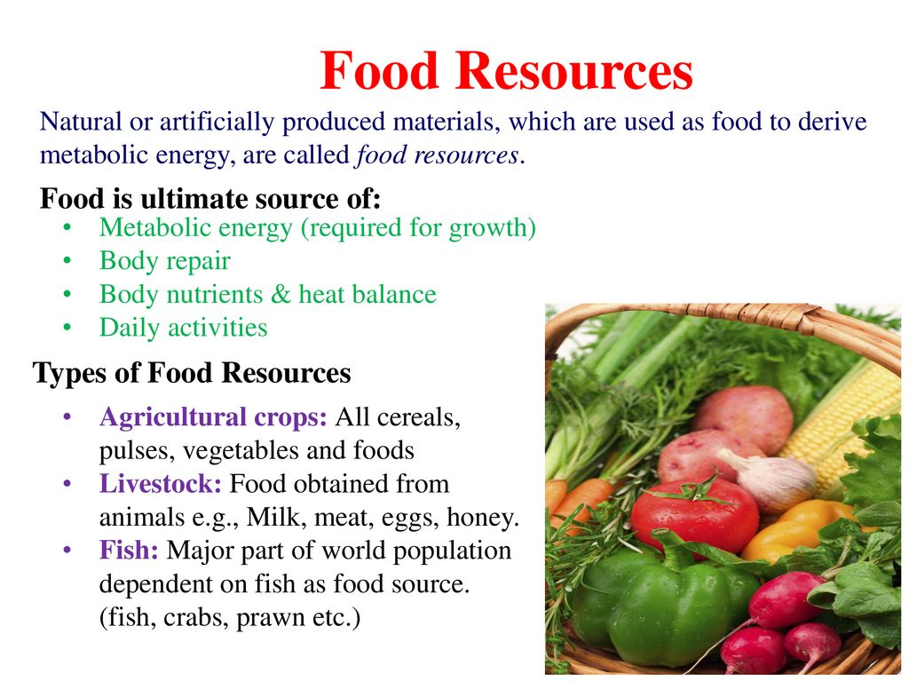
Food Resources(CO2.)
Food
It is essential for growth and development of living organisms.
These essential materials are called nutrients and these nutrients are available from variety of animals and plants.
There are thousands of edible plants and animals over the world, out of which only about three dozen types constitute major food of humans.
Food sources
The majority of people obtain food from cultivated plants and domesticated animals.
Although some food is obtained from oceans and fresh waters, but the great majority of food for human population is obtained from traditional land-based agriculture of crops and livestock.
.http://ecoursesonline.iasri.res.in/mod/page/view.php?id=4533

Slide 59
Food Resources(CO2.)
Food crops
It is estimated that out of about 2,50,000 species of plants, only about 3,000 have been tried as agricultural crops.
Under different agro-climatic condition, 300 are grown for food and only 100 are used on a large scale.
Some species of crops provide food, whereas others provide commercial products like oils, fibres, etc.
Raw crops are sometimes converted into valuable edible products by using different techniques for value addition .
At global level, only 20 species of crops are used for food.
These, in approximate order of importance are wheat, rice, corn, potatoes; barley, sweet potatoes, cassavas, soybeans, oats, sorghum, millet, sugarcane, sugar beets, rye, peanuts, field beans, chick-peas, pigeon- peas, bananas and coconuts.
Many of them are used directly, whereas other can be used by changing them by using different techniques for enhancing calorific value.

Slide 60
Food Resources(CO2.)
Livestock
Domesticated animals are an important food source.
The major domesticated animals used as food source by human beings are ‘ruminants’ (e.g. cattle, sheep, goats, camel, reindeer, llama, etc.).
Ruminants convert indigestible woody tissue of plants (cellulose) which are earth’s most abundant organic compound into digestible food products for human consumption.
Milk, which is provided by milking animals, is considered to be the complete food.
Other domestic animals like sheep, goat, poultry and ducker can be used as meat.
Aquaculture
Fish and seafood contributes 17 million metric tonnes of high quality protein to provide balance diet to the world.
Presently aquaculture provides only small amounts for world food but its significance is increasing day by day.

Slide 61
Food Resources(CO2.)
World Food Problems
As per estimates of Food and Agriculture Organization (FAO), about 840 million people remain chronically hungry and out of this 800 million are living in the developing world.
In last decade, it is decreasing at the rate of 2.5 million per year, but at the same time world’s population is increasing.
Target of cutting half the number of world’s chronically hungry and undernourished people by 2015 will difficult to meet, if the present trend continues.
Due to inadequate purchasing power to buy food, it is difficult to fulfil minimum calorific requirement of human body per day.
Large number of people are in India are poor which can be attribute to equitable distribution of income.
Food insufficiency can be divided into two categories into under-nourishment and malnourishment. Both of these insufficiencies are global problems.

Slide 62
Food Resources(CO2.)
Under-nourishment
The FAO estimates that the average minimum daily caloric intake over the whole world is about 2,500 calories per day.
People who receive less than 90% of their minimum dietary intake on a long-term basis are considered undernourished.
Those who receive less than 80% of their minimum daily caloric intake requirements are considered ‘seriously’ undernourished.
Children in this category are likely to suffer from stunted growth, mental retardation, and other social and developmental disorders.
Therefore, Under-nourishment means lack of sufficient calories in available food, resulting in little or no ability to move or work.

Slide 63
Food Resources(CO2.)
Malnourishment
Person may have excess food but still diet suffers from due to nutritional imbalance or inability to absorb or may have problem to utilize essential nutrients.
If we compare diet of the developed countries with developing countries people in developed countries have processed food which may be deficient in fibre, vitamins and other components .
Where as in the diet of developing countries, may be lack of specific nutrients because they consume less meat ,fruits and vegetables due to poor purchasing power .
Malnourishment can be defined as lack of specific components of food such as proteins, vitamins, or essential chemical elements.

Slide 64
Food Resources(CO2.)
The major problems of malnutrition are:
Marasmus: a progressive emaciation caused by lack of protein and calories.
Kwashiarkor: a lack of sufficient protein in the diet which leads to a failure of neural development and therefore learning disabilities.
Anemia: it is caused by lack of iron in the diet or due to an inability to absorb iron from food.
Pellagra: it occurs due to the deficiency of tryptophan and lysine, vitamins in the diet.
Every year, food problem kill as many people as were killed by the atomic bomb dropped on Hiroshima during World War II.
This shows that there is drastic need to increase food production, equitably distribute it and also to control population growth.
Although India is the third largest producer of staple crops, it is estimated that about 300 million Indians are still undernourished.
India has only half as much land as USA, but it has nearly three times population to feed. Our food problems are directly related to population.

Slide 65
Food Resources(CO2.)
Changes Caused by Agriculture and Overgrazing
From centuries, agriculture is providing inputs to large number of industries involved in production, processing and distribution of food.
Accordingly, agriculture has significant effect on environment.
Local level,
Regional level,
Global level.
The agriculture also makes impact on the usage of land generally as follows:
Deforestation Soil Erosion Depletion of nutrients Impact related to high yielding varieties (HYV)
Fertilizers related problems include micronutrient imbalance, nitrite pollution and eutrophication.
Pesticide related problems include creating resistance in pests and producing new pests, death of non-target organisms, biological magnification.
Some other problems include water logging, salinity problems etc.

Slide 66
Food Resources(CO2.)
Changes Caused by Overgrazing
The carrying capacity of land for cattle depends upon micro climate and soil fertility. If carrying capacity is exceeded than land is overgrazed.
Because of overgrazing the agricultural land gets affected as follows,
Reduction in growth and diversity of plant species
Reduce plant cover leads to increased soil erosion
Cattle trampling leads to land degradation

Slide 67
Food Resources(CO2.)
Effects of Modern Agriculture
For sustainable production modern techniques are used to enhance productivity of different cropping systems under different agro-eco-zones.
Adoption of modern agricultural practises has both positive and negative effects on environment.
Effects of modern agriculture are briefly discussed under different heads as under:
Soil erosion
Irrigation
Agriculture and the loss of genetic diversity
Fertilizer-pesticide problems

Slide 68
Food Resources(CO2.)
Soil erosion
Raindrops bombarding bare soil result in the oldest and still most serious problem of agriculture.
The long history of soil erosion and its impact on civilization is one of devastation. Eroded fields record our failure as land stewards.
Irrigation
Adequate rainfall is never guaranteed for the dry land farmer in arid and semiarid regions, and thus irrigation is essential for reliable production.
Irrigation ensures sufficient water when needed and also allows farmers to expand their acreage of suitable cropland.
In fact, we rely heavily on crops from irrigated lands, with fully one-third of the world's harvest coming from that 17% of cropland that is under irrigation.
Unfortunately, current irrigation practices severely damage the cropland and the aquatic systems from which the water is withdrawn.

Slide 69
Food Resources(CO2.)
Agriculture and the loss of genetic diversity
As modern agriculture converts an ever-increasing portion of the earth's land surface to monoculture, the genetic and ecological diversity of the planet erodes.
Both the conversion of diverse natural ecosystems to new agricultural lands and the narrowing of the genetic diversity of crops contribute to this erosion.
Fertilizer-pesticide problems
For photosynthesis apart from water, sunshine and CO_{2,} plants need micro and macro nutrients for growth.
These nutrients are supplied in the shape of fertilizers.
There is lot of potential to increase food productivity by increasing fertilizer use.
On one hand application of artificial chemical fertilizers increases the productivity at faster rate as compare to organic fertilizers, on the other hand application of fertilizers can be a serious problem of pollution and can create number of problems.
Excessive level of nitrates in ground water has created problems in developed countries. These are:

Slide 70
Food Resources(CO2.)
a. Accumulated phosphorous as a consequence of use of phosphoric fertilizer are posing serious threat as residues in domestic water supply and for ecology of river and other water bodies. Increased level of phosphates in different water results in eutrophication.
b. Effect of chemical fertilizer is long term, therefore leads to net loss of soil organic matter.
To control insects, pests, diseases and weeds which are responsible for reduction in productivity different chemicals are used as insecticides, pesticides and herbicides.
Successful control of insects, pests and weeds increases productivity and reduces losses and provide security for harvest and storage.
Applications of these synthetic chemicals have great economic values and at the same time cause number of serious problems such as:
a. Affects human health which includes acute poisoning and illness caused by higher doses and accidental exposes
b. As long term effect, cause cancer, birth defects, Parkinson’s disease and other regenerative diseases.
c. Long term application of pesticides can affect soil fertility.
d. Danger of killing beneficial predators.
e. Pesticides resistance and pest resurgence

Slide 71
Food Resources(CO2.)
Water Logging
High water table or surface flooding can cause water logging problems .
Water logging may lead to poor crop productivity due to anaerobic condition created in the soil.
In India, deltas of Ganga, Andaman and Nicobar Islands and some areas of Kerala are prone to frequent water logging.
Salinity
Due to adoption of intensive agriculture practices and increased concentration of soluble salts leads to salinity.
Due to poor drainage, dissolved salts accumulate on soil surface and affects soil fertility.
Excess concentration of these salts may form a crust on the surface which may injurious to the plants.
The water absorption process is affected and uptake of nutrient is disturbed.
According to an estimate, in India, 7 million hectare of land is saline and area is showing in increasing trends due to adoption of intensive agriculture practises.

Slide 72
Food Resources(CO2.)
5.7 Case Studies
A study on birth defects in water birds, in Kester son wildlife refuge in California, indicated that these defects where due to high concentration of selenium.
Recent reports from cotton growing belt of Punjab which covers Abohar, Fazalka and part of Bathinda indicates that over use of pesticides for control of insect pest in cotton to enhance productivity has not only affected soil health, but also caused cancer in human being.
Diclofenac is the drug for veterinary use to treat the live stocks which have strong residual nature, which leads to high persistence throughout the food chain .Due to biomagnification it becomes more dangerous to the vultures as they are consumers of diclofenac treated cattle. Diclofenac is responsible for bringing three South Asian species of Gyps vultures to the brink of extinction. It has been banned in India since 2006.

Slide 73
Land Resources(CO2.)
Land is a natural resource of utmost importance. It supports natural vegetation, wildlife, human life, economic activities, transport and communication systems. India has land under a variety of relief features, namely; mountains, plateaus, plains and islands .
Land resources are used for the following purposes:
Forests
Land not available for cultivation
a) Barren and wasteland
b) Land put to non-agricultural uses
Fallow lands
Other uncultivated lands (excluding fallow land)
Net sown area
Land Use Pattern in India
The use of land is determined
Physical factors: such as topography, climate, soil types
Human factors: such as population density, technological capability and culture and traditions etc.
http://ecoursesonline.iasri.res.in/mod/page/view.php?id=4537

Slide 74
Land Resources(CO2.)
Land as a Resource
Land area constitutes about 1/5 of the earth surface.
To meet out the challenging demand of food, fibre and fuel for human population, fodder for animals and industrial raw material for agro based industries, efficient management of land resources will play critical role.
Soil, water, vegetation and climate are basic natural resources for agricultural growth and development.
Land Degradation
Due to increasing population, the demands for arable land for producing food, fibre and fuel wood is also increasing.
Hence there is more and more pressure on the limited land resources which are getting degraded due to over-exploitation.
Nearly 56% of total geographical area of the country is suffering due to land resource degradation.
Out of 17 million hectare canal irrigated area, 3.4 million hectare is suffering from water logging and salinity.
Soil erosion, water logging, salinization and contamination of the soil with industrial wastes like fly-ash, press mud or heavy metals all cause degradation of land.

Slide 75
Land Resources(CO2.)
Soil Erosion
Soil erosion refers to loss or removal of superficial layer of soil due to the action of wind, water and human factors.
In other words, it can be defined as the movement of soil components, especially surface-litter and top soil from one place to another.
It has been estimated that more than 5000 million tonnes topsoil is being eroded annually and 30% of total eroded mass is getting loosed to the sea .
It results in the loss of fertility.
It basically is of two types, viz. geologic erosion and accelerated erosion.
Various factors which affect soil erosions include soil type, vegetation cover, slope of ground, soil mismanagement and intensity and amount of rainfall.
Wind is also responsible for the land erosion through saltation, suspension and surface creep. In order to prevent soil erosion and conserve the soil the following conservation practices are employed,
Conservational till farming, Contour farming and Terracing
Strip cropping and alley cropping
Wind breaks or shelterbelts

Slide 76
Land Resources(CO2.)
Salinization
It refers to accumulation of soluble salts in the soil.
Concentration of soluble salts increases due to poor drainage facilities.
In dry land areas, salt concentration increases where poor drainage is accompanied by high temperature.
High concentration of salts affects the process of water absorption hence affects the productivity.
Water Logging
Excessive utilization of irrigation may disturb the water balance which can lead to water logging due to rise of water table .
Anaerobic condition due to poor availability of oxygen in water logged soils may affect respiration process in plants which will ultimately affect the productivity of water logged soil.
Desertification
Desertification is a process whereby the productive potential of arid or semiarid lands falls by ten percent or more.
Desertification is characterized by devegetation and depletion of groundwater, salinization and severe soil erosion.

Slide 77
Land Resources(CO2.)
Causes of desertification
Deforestation
Overgrazing
Mining and quarrying
Shifting Cultivation
Shifting cultivation is a practice of slash and burn agriculture adopted by tribal communities and is a main cause for soil degradation particularly tropical and sub tropical regions.
Shifting cultivation which is also popularly known as ‘Jhum Cultivation’ has lead to destruction of forest in hilly areas .
It is responsible for soil erosion and other problems related to land degradation in mountainous areas.
Man Induced Landslides
Human race has exploited land resources for his own comfort by constructing roads, railway tracks, canals for irrigation, hydroelectric projects, large dams and reservoirs and mining in hilly areas.
Moreover productive lands under crop production are decreasing because of development activities.
These factors are affecting the stability of hill slopes and damage the protective vegetation cover.
These activities are also responsible to upset the balance of nature and making such areas prone to landslides.

Slide 78
Water Resources(CO2.)
Water resources
These are natural resources of water that are potentially useful as a source of water supply.
97% of the water on the Earth is salt water and only three percent is fresh water.
Slightly over two thirds of this is frozen in glaciers and polar ice caps.
The remaining unfrozen freshwater is found mainly as groundwater, with only a small fraction present above ground or in the air.
Sources
Natural sources of fresh water include surface water, under river flow, groundwater and frozen water.
Artificial sources of fresh water can include treated wastewater (reclaimed water) and desalinated seawater.
Uses of water following Activities
Agricultural,
Industrial,
Household,
Recreational
Environmental

Slide 79
Water Resources(CO2.)
Water related problems
Waterborne diseases
These are caused by pathogenic micro-organisms (protozoa ,bacteria, viruses ) that are transmitted in water., such as fever, cholera, dysentery, diarrhea and others.
Water-washed diseases
Water-washed diseases are caused by poor personal hygiene that results from an inadequate supply of clean water.
Typical water-washed diseases include shigella, which is a skin infection and scabies & trachoma, which are eye infections and highly contagious.
Water-based diseases
These diseases are transmitted by aquatic hosts, such as worms.
They penetrate the skin while cleaning or bathing with contaminated water.
Some hosts such as Salmonella enterica serotype Typhi bacteria can enter our body through unclean drinking water.
This can cause Typhoid, which is a form of severe bacterial infection and causes diarrhea, vomiting, fever and jaundice.
Water-based diseases can also be fatal. For example, Schistosomiasis, a deadly parasitic water based infection can damage the liver, lungs, intestines and bladder of a human body.

Slide 80
Water Resources(CO2.)
Water-related insect vectors diseases (Water induced diseases )
These diseases are spread by insects which form habitats on stagnant water sources.
For this reason, the diseases they cause aren’t as related to water as those more directly transmitted by water.
Some water-related insect vector diseases include malaria, filariasis, yellow fever, and river blindness.
The most common of these, Malaria, is transmitted through the mosquitos which breed on fresh or brackish water.
The malarial parasite destroys red blood cells, and induce fever, head and muscle aches, nausea, diarrhea, and even jaundice.
In extreme cases, malaria victims may have convulsions, comas, or kidney failures resulting in death. Malaria is one of the greatest killers in all of human history.
Diseases caused by defective sanitation
Some diseases caused by defective sanitation practices.
Hookworm is contracted by contact with contaminated soil which has a huge mass of human feces.
Hookworm larvae penetrate human skin to reach out to the small intestine, where it breeds and grows in number.

Slide 81
Water Resources(CO2.)
Arsenic Problem
Arsenic is found in groundwater, many chemicals, and foods.
If arsenic is in the organic form, it is likely nontoxic or weakly toxic to humans, but inorganic arsenic can also be found in similar locations and materials and in high concentrations in industrial processes.
In 2013, the FDA made recommendations that less than 10 parts per billion of arsenic was acceptable for levels in apple juice.
If arsenic poisoning occurs over a brief period of time, symptoms may include vomiting, abdominal pain, encephalopathy, and watery diarrhoea that contains blood.
Long-term exposure can result in thickening of the skin, darker skin, abdominal pain, diarrhoea, heart disease, numbness, and cancer.^{[1]}

Slide 82
Water Resources(CO2.)
Fluoride problem
World Health Organization (WHO) has set the upper limits of drinking water standards at 1.5 mg/l, and the Bureau of Indian Standards, has therefore, laid down Indian drinking water standards as 1.0 mg/l as maximum permissible limit of fluoride with further remarks as ‘lesser the better’.
Intake of fluoride higher than the optimum level is the main reason for dental and skeletal fluorosis.
The main source in groundwater is from fluoride rich rocks.
Teeth fluorosis
Exposure to high concentrations of fluoride during childhood, when teeth are developing, can result in mild dental fluorosis.
There will be tiny white streaks or specks in the enamel of the tooth.
This does not affect the health of the teeth, but the discoloration may be noticeable.
Breastfeeding infants or making up formula milk with fluoride-free water can help protect small children from fluorosis.
Skeletal fluorosis
Excess exposure to fluoride can lead to a bone disease known as skeletal fluorosis.
Over many years, this can result in pain and damage to bones and joints.
The bones may become hardened and less elastic, increasing the risk of fractures.
If the bones thicken and bone tissue accumulates, this can contribute to impaired joint mobility.

Slide 83
Wasteland and its conservation(CO2..)
Waste land is the land put to other non-agricultural uses which include rocky, arid and desert areas, roads, railways, industry etc.
Continuous use of land over a long period of time without taking appropriate measures to conserve and manage it, has resulted in land degradation.
Land Degradation and Conservation Measures
Human activities such as deforestation, overgrazing, mining and quarrying have contributed significantly to land degradation.
Mining sites leave deep scars and traces of over-burdening the land.
In recent years, industrial effluents as waste have become a major source of land and water pollution in many parts of the country.

Slide 84
Importance of soil conservation(CO2..)
The earth is the primary condition and environment for crops that nourish humans as well as domestic animals and wildlife. Since the majority of plants can’t exist without earth, it is significant to use this resource sparingly.
The approach enables us to have enough food in the future, and material for technical needs, for example, household textile or fuel.
The importance of soil conservation also relates to water supply, and earth layers function as natural filters to improve water quality. In its turn, water is necessary to dissolve nutrients for plants.
Wise usage of land resources ensures its availability for the next generations, and thus affordable prices for food in the future.
Another aspect is the aesthetic side, as abundant vegetation scenery pleases the eye far more than devastated and abandoned areas.

Slide 85
Benefits Of Soil Conservation(CO2)
Humankind in general and farmers in particular benefit from numerous advantages of soil conservation. This agricultural practice contributes to sustainability in a number of ways:
Boosts earth quality and productivity. Maintaining the natural environment for earth-dwelling organisms increases fertility and reduces the necessity of chemical fertilizing, thus boosting yields and saving costs at the same time.
Mitigates erosion. Soil conservation methods to reduce erosion and depletion help agriculturalists to avoid the expansion of new lands when territories become infertile.
Promotes water infiltration and increases its storage. The soil conservation technique of minimum tillage vs. conventional plowing affects soil moisture by reducing cracking and evaporation as well as rising the infiltration rate.
Aids air and water purification. The importance of soil conservation relates to water supplies, and the earth functions as a natural filter to purify water.
Gives food and shelter for wildlife. Land with growing vegetation is a living environment for animals; it is not only the source for nourishment but their home as well.

Slide 86
Soil Conservation Practices(CO2..)
Different types of soil conservation methods ensure long-term usage of land and keep it productive for future generations.
Conservation Tillage
The soil conservation technique aims at addressing wind and water erosion by covering the earth with vegetation (either crops or their residues) and limiting the number of tilling operations.
Another significant aspect is to choose the proper time for field operations, depending on the soil types.
For example, clay ones are better to till after harvesting while other types are better to plow before seeding. Also, handling wet soils leads to their compaction
No till farming assists in soil conservation as well since it implies no or minimum disturbance and planting seeds into the crop residue.
The basic idea is not to leave soil bare, as bare areas are highly prone to erosion, and plants keep it in place with their root systems.
Additionally, vegetation accumulates moisture for future crops.

Slide 87
Soil Conservation Practices(CO2..)
Crop Rotation
Crop rotation vs. mono cropping farming suggests changing agro species instead of planting one and the same for many subsequent seasons. Farmers applying this soil conservation method reap numerous benefits
Cover Crops
This soil conservation technique is another way to avoid bare soils and additionally benefit from planting cover crops – secondary species – in-between growing cash crops for different reasons like to:
produce forage and grazing material for cattle;
provide green manure;
assist in weed control
retain moisture;
ensure a natural environment for microorganisms and minor animals;

Slide 88
Equitable Use of Resources for Sustainable Life Style(CO2)
Equitable Use of Resources for Sustainable Life Style
In last 50 years, the consumption of resource in the society has increased many folds.
There is a big gap in the consumers lifestyle between developed and developing countries.
Urbanization has changed the life style of middle class population in developing countries creating more stress on the use of natural resources.
It has been estimated that More Developed Countries (MDC) of the world constitute only 22% of world’s population but they use 88% of natural resources.
These countries use 73% of energy resources and command 85% of income and in turn they contribute very big proportion of pollution.
On the other hand less developed countries (LDCs) have moderate industrial growth and constitute 78% of world’s population and use only 12% of natural resources, 27% of energy and have only 15% of global income.
http://ecoursesonline.iasri.res.in/mod/page/view.php?id=4539

Slide 89
Equitable Use of Resources for Sustainable Life Style(CO2)
There is a huge gap between rich and poor.
In this age of development the rich have gone richer and the poor is becoming more poorer.
This has lead to unsustainable growth.
There is an increasing global concern about the management of natural resources.
The solution to this problem is to have more equitable distribution of resources and income.
Two major causes of unsustainability
Over population in poor countries
Over consumption of resources by rich countries.
For equitable use of natural resources
More developed countries/rich people have to lower down their level of consumption to bare minimum so that these resources can be shared by poor people to satisfy their needs.
Time has come to think that it is need of the hour that rich and poor should make equitable use of resources for sustainable development of mankind.

Slide 90
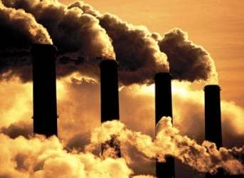
Non Renewable Energy Resources(CO2)
Fossil fuels
Fossil fuels are the fuels formed by natural resources, these fuels are formed in the Earth crust over millions of years from decayed organisms & produce carbon dioxide on burning.
A fossil fuel is a formed by natural processes, the dead plants by exposure to heat and pressure in the Earth's crust over millions of years.
Like anaerobic decomposition of buried dead organisms, containing organic molecules originating in ancient photosynthesis that release energy in combustion.
Such organisms and their resulting fossil fuels typically have an age of millions of years, and sometimes more than 650 million years.

Slide 91
Non Renewable Energy Resources(CO2)
Fossil fuels :
Fossil fuels contain high percentages of carbon and include petroleum, coal, and natural gas.
Commonly used derivatives of fossil fuels include kerosene and propane.
Fossil fuels range :
from volatile materials with low carbon-to-hydrogen ratios (like methane),
to liquids (like petroleum),
to nonvolatile materials composed of almost pure carbon, like anthracite coal.
The world's main primary energy sources consisted of petroleum (34%), coal (27%), and natural gas (24%), amounting to an 85% share for fossil fuels in primary energy consumption in the world.
Non-fossil sources included nuclear (4.4%), hydroelectric (6.8%), and other renewables (4.0%, including geothermal, solar, tidal, wind, wood, and waste)
https://www.slideshare.net/danbel2/fossil-fuels-powerpoint?next_slideshow=1

Slide 92
Non Renewable Energy Resources(CO2)
Non-renewable energy is a source of energy that will eventually run out.
Non-renewable energy is energy derived from finite resources .
These are also known as conventional energy resources.
Most non-renewable energy sources are fossil fuels such as petroleum and crude oil, coal, and natural gas, but nuclear fuel, mainly used to produce electricity, is also generally classified as non-renewable.
Coal
Coal is a solid fossil fuel formed in several stages & were subjected to intense heat and pressure over millions of years.
Various stages of coal
Wood → Peat (60% carbon)→ Lignite(70% carbon) → Bituminous coal (80% Carbon) → Anthracite (90% carbon)
Disadvantages
When coal is burnt it produces CO₂ causes global warming
Coal contains impurities like S and N, it produces toxic gases during burning
http://ecoursesonline.iasri.res.in/mod/page/view.php?id=4535

Slide 93
Non Renewable Energy Resources(CO2)
Natural gas
It is a widely available fossil fuel with estimated 850 000 km³ in recoverable reserves and at least that much more using enhanced methods to release shale gas.
At present usage rates, natural gas could supply most of the world's energy needs for between 100 and 250 years, depending on increase in consumption over time.
Natural gas (also called fossil gas; sometimes just gas)
It is a naturally occurring hydrocarbon gas mixture consisting of methane and commonly including varying amounts of other higher alkanes, and sometimes a small percentage of carbon dioxide, nitrogen, hydrogen sulfide, or helium.
Natural gas is colorless and odorless, and explosive, so a sulfur-smell (similar to rotten eggs) is added for early detection of leaks.
Natural gas is formed when layers of decomposing plant and animal matter are exposed to intense heat and pressure under the surface of the Earth over millions of years.
The energy that the plants originally obtained from the sun is stored in the form of chemical bonds in the gas.

Slide 94
Non Renewable Energy Resources(CO2)
Uses
It is a non-renewable hydrocarbon used as a source of energy for heating, cooking, and electricity generation.
It is also used as a fuel for vehicles and as a chemical feedstock in the manufacture of plastics and other commercially important organic chemicals.
Sources
It is found in deep underground rock formations or associated with other hydrocarbon reservoirs in coal beds and as methane clathrates.
Petroleum is another fossil fuel found close to and with natural gas.
Most natural gas was created over time by two mechanisms: biogenic and thermogenic.
Biogenic gas is created by methanogenic organisms in marshes, bogs, landfills, and shallow sediments.
Deeper in the earth, at greater temperature and pressure, thermogenic gas is created from buried organic material.

Slide 95
Non Renewable Energy Resources(CO2)
Nuclear Energy
Nuclear energy comes from the nucleus of atoms.
The energy is released by nuclear fusion (nuclei are fused together) or nuclear fission (nuclei are split apart).
Nuclear plants use nuclear fission of a radioactive element called uranium to generate electricity.
Origin of Nuclear Energy
Atoms – the particles that make up every object in the universe – consist of neutrons, protons and electrons.
They contain a nucleus, which is where nuclear energy comes from.
Nuclear energy is released from an atom through
Nuclear fusion, when nuclei of atoms are combined or fused together. This is how the Sun produces energy.
Nuclear fission, when nuclei of atoms are split apart. This is the method used by nuclear plants to generate electricity.

Slide 96
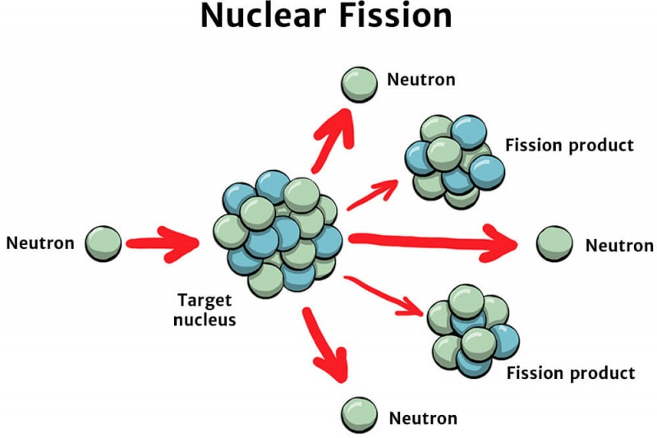
Non Renewable Energy Resources(CO2)
Production of nuclear Energy
A particular form of uranium – called uranium-235 – is most commonly used for energy production, as its nucleus splits easily when it is bombarded by a neutron.
Here's what happens during a nuclear fission reaction:
The nucleus of a uranium atom is bombarded by a neutron, causing it to split into two atoms
At the same time, energy is released as heat and radiation
As a result of the fission reaction, more neutrons are released
These neutrons then start bombarding other uranium atoms, so the process keeps repeating itself.
This is called a chain reaction

Slide 97
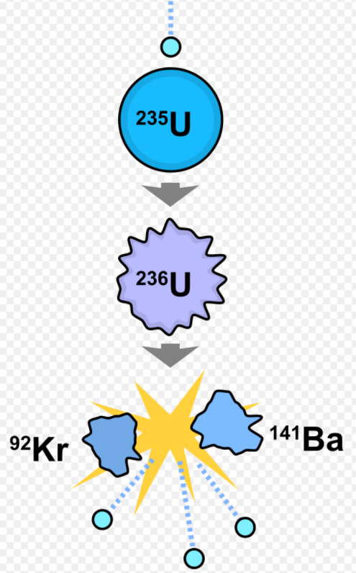
Non Renewable Energy Resources(CO2)
Nuclear reactions
Nuclear fission reaction involves the absorption of neutrons by a heavy nucleus, which causes it to split into two or more lighter nuclei and release huge amount of energy.
Examples:
An important example of nuclear fission is the splitting of the uranium-235 nucleus when it is bombarded with neutrons. Various products can be formed from this nuclear reaction, as described in the equations below.
²³⁵U₉₂ + ¹n → ¹⁴¹Ba + ⁹²Kr + 3 ¹n
²³⁵U + ¹n → ¹⁴⁴Xe + ⁹⁰Sr + 2 ¹n
²³⁵U + ¹n → ¹⁴⁶La + ⁸⁷Br + 3 ¹n
²³⁵U + ¹n → ¹³⁷Te + ⁹⁷Zr + 2 ¹n
²³⁵U + ¹n → ¹³⁷Cs + ⁹⁶Rb + 3¹n
Another important example of nuclear fission is the splitting of the plutonium-239 nucleus.

Slide 98
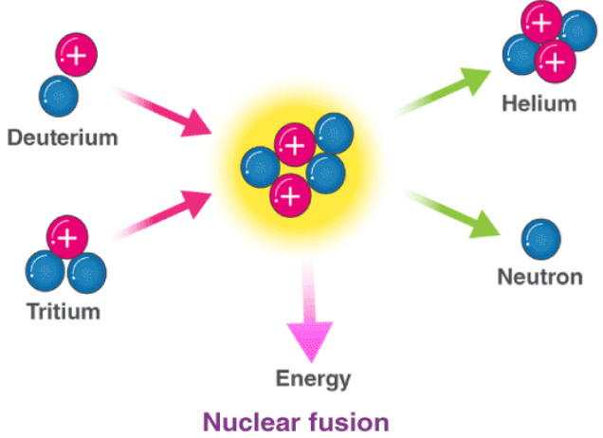
Non Renewable Energy Resources(CO2)
Nuclear reactions
Nuclear fusion reactions are the processes in which two relatively light nuclei combine via a collision to form a single, heavier nucleus and release huge amount of energy.
⁶₃Li + ²₁H → 2 ⁴₂He + 22.2 MeV.
³₁H + ²₁H → ⁴₂He + ¹₀n.+17.6 MeV.
H + ¹¹B → 3(₂⁴He); Q = 8.68 MeV;
H + ⁶Li →₂³He +₂⁴He; Q = 4.023 MeV;
³He + ⁶Li → H + 2(⁴He); Q = 16.88 MeV;
³He + ⁶Li → D + ⁷Be; Q = 0.113 MeV.

Slide 99
Non Renewable Energy Resources(CO2)
The applications of nuclear energy include the following
These are used at nuclear power plants to generate electricity & also used in nuclear marine propulsion.
Nuclear power plants supply the required energy to produce electrical energy.
These drive the propellers of ships otherwise to turn the shafts of electrical generators.

Slide 100
Non Renewable Energy Resources(CO2)
Petroleum
Also referred to as oil or crude oil, petroleum keeps much of the world’s wheels spinning: about half of the world’s supply of this liquid fossil fuel is converted into gasoline.
Petroleum is an easily portable source of (nonrenewable) energy that allows people to stay on the move.
But the disadvantages of petroleum in this day and age cannot be ignored: burning gasoline releases toxins into the air that humans breathe.
Oil is extracted via a range of drilling methods that carry with them many inherent risks, including possible oil spills, which can be devastating for the environment.

Slide 101
Renewable Energy Resources(CO2)
Renewable energy
It is useful energy that is collected from renewable resources, which are naturally replenished on a human timescale, including carbon neutral sources like sunlight, wind, rain, tides, waves, and geothermal heat.
It provides energy in four important areas: electricity generation, air and water heating/cooling, transportation, and rural (off-grid) energy services.
Solar energy
Solar energy is the energy obtained by capturing light and heat (E = hν)from the Sun .
Energy from the Sun is referred to as solar energy
It is considered a green technology because it does not emit greenhouse gases
Solar energy is abundantly available and has been utilized since long both as electricity and as a source of heat
Solar technology can be broadly classified as :
1.Active solar system
2.Passive solar system
Both active and passive solar energy systems can convert the sun’s rays into direct electricity, but their mechanisms are a bit different from each other
https://en.wikipedia.org/wiki/Renewable_energy

Slide 102
Renewable Energy Resources(CO2)
Solar energy capacity
Global electricity power generation capacity | 714 GW (2020)
Global electricity power generation capacity annual growth rate | 29% (2011-2020)
Share of global electricity generation | 2% (2018)
Levelized cost per megawatt hour | Utility-scale photovoltaics: USD 38.343 (2019)
Primary technologies | Photovoltaics, concentrated solar power, solar thermal collector
Other energy applications | Water heating; heating, ventilation, and air conditioning (HVAC); cooking; process heat; water treatment

Slide 103
Renewable Energy Resources(CO2)
Uses
Used in calculators, electronic watches. Street lights, water pumps to run radios and TVs.
Solar Battery
Large number of solar cells is connected in series to form a solar battery.
Solar battery produce more electricity which is enough to run water pump, to run street-light, etc.,

Slide 104
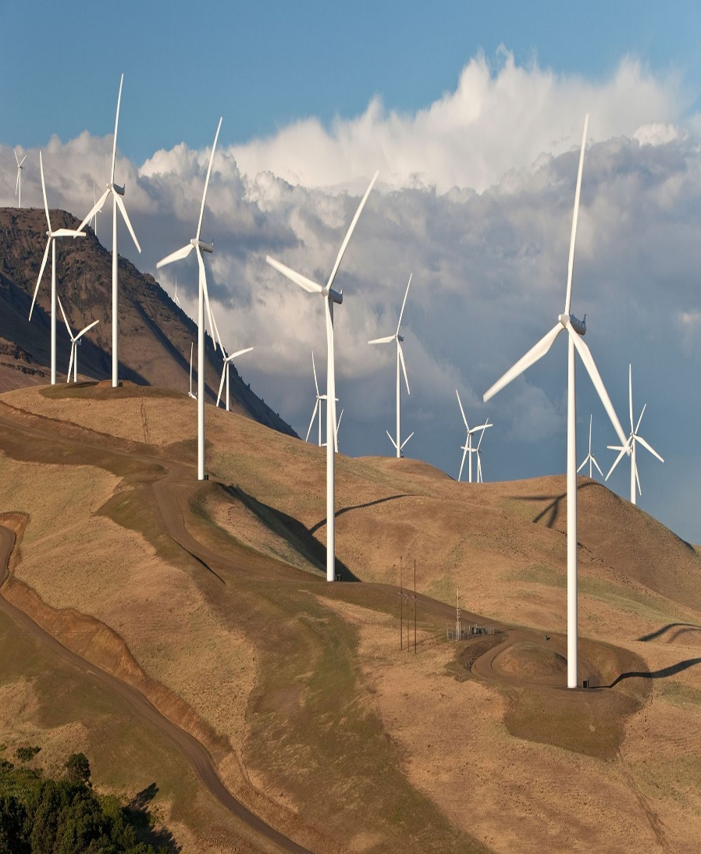
Renewable Energy Resources(CO2)
Wind energy (Wind power)
Airflows can be used to run wind turbines
Wind energy is used in wind mills which converts the kinetic energy of the wind into mechanical or electrical energy
The kinetic energy of wind can be used to do mechanical work like lifting water from wells or grinding grains in flour mills
A single wind mill produces only a small amount of electricity
Large number of wind mills in a large area are coupled together to produce more electricity in wind energy farms

Slide 105
Renewable Energy Resources(CO2)
Wind energy (Wind power)
The minimum wind speed required is 15 km/hr
Largest wind farm is near Kanyakumari in Tamilnadu generate 380 MW electricity
Wind power or wind energy is the use of wind
To provide mechanical power through wind turbines
To turn electric generators for electrical power.
Wind power is a popular sustainable, renewable energy source that has a much smaller impact on the environment compared to burning fossil fuels.

Slide 106
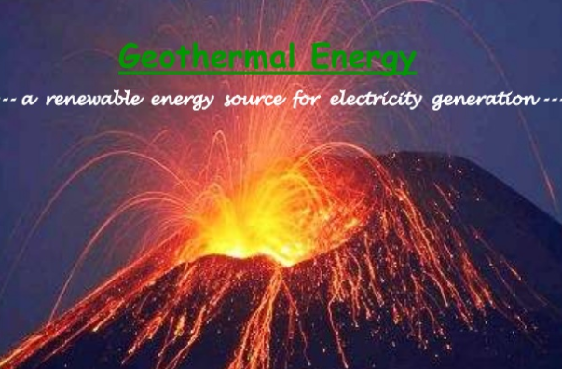
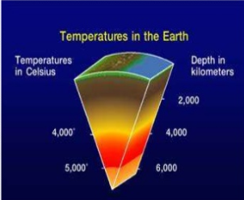
Renewable Energy Resources(CO2)
Geo-thermal energy
It is the thermal energy which generated and stored in the Earth.
Thermal energy is the energy that determines the temperature of matter.
The geothermal energy of the Earth's crust originates from the original formation of the planet and from radioactive decay of materials.
The geothermal originates from the Greek roots geo (gê), meaning Earth, and (thermós), meaning hot.
It is simply the heat energy of the earth, generated by various natural processes, such as:
Heat from when the planet formed & accreted, which has not been yet lost
Decay of radioactive elements
Friction

Slide 107
Renewable Energy Resources(CO2)
The earth's internal heat is a thermal energy generated from radioactive decay and continual heat loss from Earth's formation.
Temperatures at the core–mantle boundary may reach over 4000 °C (7200 °F).
The high temperature and pressure in Earth's interior cause some rock to melt .
Rock and water is heated in the crust, sometimes up to 370 °C (700 °F).
Sources
Reservoirs can be suspected in the areas where we find
Geyser
Boiling mud pot
Volcano
Hot springs

Slide 108
Renewable Energy Resources(CO2)
Extraction :
To produce power from geothermal energy, wells are dug a mile deep into underground reservoirs to access the steam and hot water there, which can then be used to drive turbines connected to electricity generators .
There are three types of geothermal power plants
Dry steam plant
Flash plant
Binary plant
Dry steam is the oldest form of geothermal technology and takes steam out of the ground and uses it to directly drive a turbine.
Flash plants use high-pressure hot water into cool, low-pressure water
Binary plants pass hot water through a secondary liquid with a lower boiling point, which turns to vapour to drive the turbine.

Slide 109
Renewable Energy Resources(CO2)
Extraction & uses
The heat energy can be brought to earth surface by following ways:
Directly from hot springs/geysers
Geo-thermal heat pump
Uses
Direct use: Hot springs used as spas, heating water at fish farms, provide heat for buildings, provide heat to industrial processes
Indirect: Electricity generation
https://www.slideshare.net/nibeditamishra/presentation-on-geothermal-energy-24231365

Slide 110
Renewable Energy Resources(CO2)
Advantages :
Environmentally Friendly
Renewable
Huge Potential around 15 terawatts (0.0035 and 2 terawatts)
Sustainable / Stable
No Fuel Required
Rapid Evolution
Disadvantages
Location Restricted
Environmental Side Effects
Earthquakes
High Costs
Sustainability

Slide 111
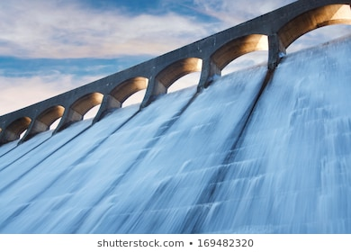
Renewable Energy Resources(CO2)
Hydropower :
It is also known as water power, is the use of falling or fast-running water to produce electricity or to power machines.
This is achieved by converting the kinetic energy of water into electrical or mechanical energy.
Hydropower is a form of sustainable energy production.
Hydropower has been used as a renewable energy source for irrigation and the operation of mechanical devices, such as gristmills, sawmills, textile mills, trip hammers, dock cranes, domestic lifts, and ore mills.

Slide 112
Renewable Energy Resources(CO2)
Type of Hydro power:
There are three types of hydropower facilities
Impoundment
Diversion
Pumped storge
Advantages :
Renewable
Emission Free
Reliable
Adjustable
Create Lakes
Faster Developed Land
Disadvantages :
Impact on Fish
Limited Plant Locations
Higher initial Costs
Carbon and Methane Emissions
Susceptible to Droughts
Flood Risk

Slide 113

Renewable Energy Resources(CO2)
Tidal power or tidal energy
It is harnessed by converting energy from tides into useful forms of power, mainly electricity using various methods.
This energy is produced from the gravitational pull from both the moon and the sun, which pulls water upwards,
while the Earth’s rotational and gravitational power pulls water down, thus creating high and low tides.
This movement of water from the changing tides is a natural form of kinetic energy.
All it takes is a steam generator, tidal turbine or the more innovative dynamic tidal power (DTP) technology to turn kinetic energy into electricity.
https://www.youtube.com/watch?v=Nai-dcyogb8
https://www.youtube.com/watch?v=VkTRcTyDSyk

Slide 114
Renewable Energy Resources(CO2)

Slide 115
Renewable Energy Resources(CO2)
Principle:
Tidal energy is taken from the Earth's oceanic tides.
Tidal forces result from periodic variations in gravitational attraction exerted by celestial bodies.
These forces create corresponding motions or currents in the world's oceans.
This results in periodic changes in sea levels, varying as the Earth rotates.
These changes are highly regular and predictable, due to the consistent pattern of the Earth's rotation and the Moon's orbit around the Earth.
The magnitude and variations of this motion reflect the changing positions of the Moon and Sun relative to the Earth, the effects of Earth's rotation, and local geography of the seafloor and coastlines.
Tidal power is the only technology that draws on energy inherent in the orbital characteristics of the Earth–Moon system, and to a lesser extent in the Earth–Sun system.

Slide 116
Renewable Energy Resources(CO2)
Advantages of tidal energy :
Environment-friendly
A highly predictable energy source
High energy density
Operational and maintenance costs are low
An inexhaustible source of energy
Disadvantages of tidal energy :
High tidal power plant construction costs
Negative influence on marine life forms
Location limits
The variable intensity of sea waves

Slide 117
Renewable Energy Resources(CO2)
Biogas
It is a mixture of gases, primarily consisting of methane and carbon dioxide, produced from raw materials such as agricultural waste, manure, municipal waste, plant material, sewage, green waste or food waste.
It is a renewable energy source.
It is produced by anaerobic digestion with anaerobic organisms or methanogen inside an anaerobic digester, biodigester or a bioreactor.
Biogas is primarily methane (CH₄) and carbon dioxide (CO₂) and may have small amounts of hydrogen sulfide (H₂S), moisture and siloxanes.
The gases methane, hydrogen, and carbon monoxide (CO) can be combusted or oxidized with oxygen.
This energy release allows biogas to be used as a fuel; it can be used in fuel cells and for any heating purpose, such as cooking.
It can also be used in a gas engine to convert the energy in the gas into electricity and heat.

Slide 118
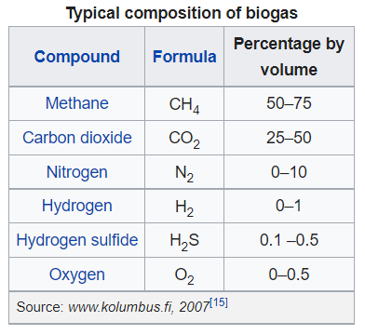
Renewable Energy Resources(CO2)
Applications
Biogas can be used for electricity production on sewage works, in a CHP gas engine, where the waste heat from the engine is conveniently used for heating the digester; cooking; space heating; water heating; and process heating.
If compressed, it can replace compressed natural gas for use in vehicles, where it can fuel an internal combustion engine or fuel cells and is a much more effective displacer of carbon dioxide than the normal use in on-site CHP plants.
https://en.wikipedia.org/wiki/Biogas

Slide 119
Ocean thermal energy (OTE)(CO2)
Ocean thermal energy (OTE)
The temperature difference between the surface level & deeper level of the oceans are used to generate electricity.
Condition The energy available due to the difference in temperature of water is called ocean thermal energy.
The temperature difference should be of 20⁰C or more between surface water and deeper water.
Process
The warm surface water of ocean is used to boil a low boiling liquid like ammonia.
The high vapour pressure thus produced turns the turbine of the generator and generates electricity.
Significance: OTE is Continuous, renewable, pollution free, used to produce H₂,

Slide 120
Hydrogen Fuel(CO2..)
Hydrogen fuel can be produced from methane or by electrolysis of water.
As of 2020, the majority of hydrogen (∼95%) is produced from fossil fuels by steam reforming or partial oxidation of methane and coal gasification with only a small quantity by other routes such as biomass gasification or electrolysis of water.
Production is usually classed in terms of colour;
Grey hydrogen' is produced as a by-product of an industrial process,
Blue hydrogen' is produced through a production process where CO₂ is also produced
finally 'green hydrogen' is produced entirely from renewable sources.
Disadvantages of hydrogen fuel
Hydrogen is highly inflammable and explosive in nature
Safe handling is required
It is difficult to store and transport.
It possesses high calorific value. It is non polluting, because the combustion product is water.
2H₂+O₂ ---------------→ 2H₂O +150 KJ

Slide 121
RENEABLE ENERGY(CO2..)
Uses
Hydrogen fuel can provide motive power for liquid-propellant rockets, cars, trucks, trains, boats and airplanes, portable fuel cell applications or stationary fuel cell applications, which can power an electric motor.
Hydrogen is considered as the primary sustainable source of renewable energy and is "highly required for advanced energy conversion systems.
https://en.wikipedia.org/wiki/Hydrogen_fuel
https://vikaspedia.in/energy/energy-basics/sources-of-energy

Slide 122
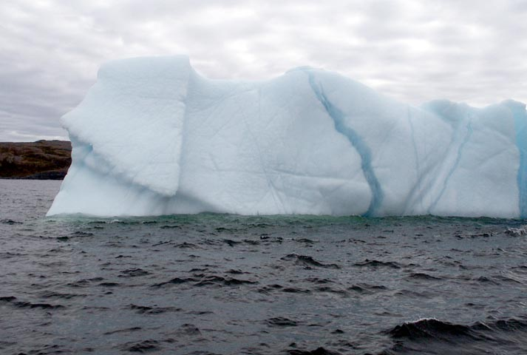
Water Recourses(CO2..)
While 67% of Earth’s surface is covered by water, only less than 2.7% of global water is freshwater. Most of the freshwater (2.05%) are locked in ice caps and glaciers. Only less than 0.7% is available for human use.

Slide 123
Scarcity of water(CO2)
On a global basis, fresh water is a increasingly scarce resource. It is partially caused by increasing population coupled by change of consumption pattern and climate changes.
Meat production use a lot of water when compared to growing food crops.
A shift in food consumption pattern toward more meat consumption will cause a substantial increase in water consumption.

Slide 124
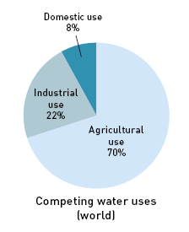
Water Recourses(CO2..)

Slide 125
Problems related to water crisis(CO2..)
Inadequate access to safe drinking water by over 1.1 billion people
Groundwater over drafting leading to diminished agricultural yields
Overuse and pollution of water resources harming biodiversity
Regional conflicts over scarce water resources sometimes resulting in warfare
Climate change causes change in frequencies of droughts and floods.
Depletion of aquifers caused by over-consumption as a result of population growth.
Pollution and contamination by sewage, agricultural and industrial runoff

Slide 126
Salinity: (CO2..)
Definition: * Water evaporation leaves behind a thin layer of salts in the topsoil. & this process of accumulation of salts is called salinity of soil.
*Saline soils are due to Sodium chloride, calcium chloride, magnesium chloride, sodium sulphate, sodium bicarbonates & sodium carbonates.
*The pH of the water exceeds 8.0
Problems in salinity
Due to salinity the soil becomes alkaline & crop yield decreases
Remedy:
The salt deposit is removed by flushing them by good quality water Salt water is flushed out by using sub-surface drainage system

Slide 127
OVER UTILIZATION OF WATER(CO2):
1. Decrease of Ground water: Reason: Increased usage of ground water Inadequate rainfall
Construction activities reduces the area for percolation of rainwater
2. Ground subsidence:
When the groundwater withdrawal is more than recharge rate ground subsidence occur.
Problems: Structural damage in buildings
Fracture in pipes
Reversing flow of canals & tidal flooding
3.Lowering of Water table:
Water pressure is lower than the atmospheric pressure, hence disturb the hydrological cycle.
Problems: Lowering of water table
Decreased pressure of water changes the speed & direction of water flow.

Slide 128
Conservation of water(CO2..)
Use minimum water for all domestic purpose
Check for water leaks in pipes & toilets & repair them properly
Reuse the soapy water after washing clothes for washing courtyards, drive ways etc.
Use drip irrigation to improve irrigation efficiency & reduce evaporation
The waste water from kitchen, bath tub can be used for watering the plants
Build rainwater harvesting system in your home

Slide 129
CONFLICTS OVER WATER(CO2)
CONFLICTS OVER WATER:
Conflicts through use:
Unequal distribution of water led to inter-state or international disputes.
Internation conflicts:
India & Pakistan fight to water from the Indus
Iran & Iraq fight for water from Shatt-al-Arab water
India & Bangladesh fight for Brahmaputra river
Mexico & USA fight over Colorado river
National Conflicts:
Cavery problem between Karnataka & Tamilnadu Krishna problem between Karnataka & Andhra Pradesh Siruveni water problem between Tamilnadu & kerala

Slide 130
Conflicts in Indian river(CO2..)
Damodar river → It is the most polluted river, carrying 43 industries discharges/
Yamuna river → 19,000 cubic meters of Water containing DDT derivatives are dumped in the river. Ganga river → 1000 cubic meters of polluted water from 68 industries are discharged in the river. Periyar river → The River is dying due to mining of 4,37,000 tones of sand everyday & become salty due to intrusion of sea water
Suriyapalayam river → 34 tanneries located around this river contaminate drinking water, & make soil unfit for agriculture.
Thamraparani river → Continous brick making on its bank has converted the river into mud pools.

Slide 131
Advantages of Rain water Harvesting(CO2..)
Advantages of Rain water Harvesting
Reduces the use of current
Prevent drought
Increase the water level in well
Rise in ground water level
Minimize soil erosion & flood hazards
Upgrading the social & environmental status
Future generation is assured of water.

Slide 132
Faculty Video Links, Youtube & NPTEL Video Links and Online Courses Details
Self Made Video Link:
Youtube/other Video Links
https://www.youtube.com/watch?v=mOwyPENHhbc, https://www.youtube.com/watch?v=yqev1G2iy20, https://www.youtube.com/watch?v=_74S3z3IO_I, https://www.youtube.com/watch?v=jXVw6M6m2g0

Slide 133
Daily Quiz(CO2)
1. A continuous are of land surrounded by ocean is called__________________
a) Seashore
b) Beach
c) Landmass
d) Wetland
Answer---c
2. How many major continuous landmass are there?
a) One
b) Two
c) Three
d) Four
Answer---d
3. Land capable of being ploughed and used to grow crops is called as________________
a) Domestic land
b) Arable land
c) Un arable land
d) Dry land
Answer (b)

Slide 134
Daily Quiz(CO2)
.4. Estimate of the ability of soils to resist erosion, based on the physical characteristics of each soil is known as__________________
a) Soil erodibility b) Soil erosion c) Soil potentiality
d) Soil neutrality
Answer---a)
5. Low lying tract of land enclosed by dikes that forms an artificial hydrological entity is known as_________________
a) Polder b) Resign c) Derelict
d) Catchment
Answer--a
6. In Germany marshes separated from the surrounding water by a dike are known as______________
a) Delt b) Koogs c) Catchment
d) Flood plains
Answer b

Slide 135
Daily Quiz(CO2)
7. Hydroponics is a technique of growing crops without__________________
a) Water b) Air c) Soil d) Sunlight
Answer c
8. The land which is abandoned and declared as not good for cultivation anymore is known as_____________
a) Polder b) Koogs
c) Derelict land d) Catchment land
Answer c
9. The thin layer of grainy substance covering the surface of the earth is called as_______________
a) Mineral b) Soil c) Sand d) Chemical fertilizers
Answer b

Slide 136
Daily Quiz(CO2)
10.. A collapse of a mass of earth or rock from a mountain is known as__________________
a) Landform
b) Landslide
c) Deforestation
d) Deformation
Answer-b

Slide 137
MCQ s
1. A continuous are of land surrounded by ocean is called__________________
a) Seashore
b) Beach
c) Landmass
d) Wetland
2. How many major continuous landmass are there?
a) One
b) Two
c) Three
d) Four
3. Land capable of being ploughed and used to grow crops is called as________________
a) Domestic land
b) Arable land
c) Un arable land
d) Dry land

Slide 138
MCQ s
4. Hydroponics is a technique of growing crops without__________________
a) Water b) Air c) Soil d) Sunlight
Answer c
5. The land which is abandoned and declared as not good for cultivation anymore is known as_____________
a) Polder
b) Koogs
c) Derelict land
d) Catchment land
Answer c
6. The thin layer of grainy substance covering the surface of the earth is called as_______________
a) Mineral
b) Soil
c) Sand
d) Chemical fertilizers
Answer b

Slide 139
MCQ(CO2)
7.On which river has Nagarjun Sager Dam been constructed?
(a) River Coyana (b) River Krishna (c) River Godavari (d) River Tapi
Answer b
8. How much percentage (%) of the Earth’s Surface is covered with water?
(a) About 70% (b) About 90% (c) About 60% (d) None of these
Answer----a
9. What is the rank of India in the world countries in the terms of Water availability per person p.a.?
(a) 129th (b) 130th (c) 131st (d) 133rd
Answer d
10: It is predicated that nearly 2 billion people will live in absolute water scarcity in the year of –
(a) 2015 (b) 2020 (c) 2025 (d) 2030
Answer--c

Slide 140
Old Question Papers
NEW SYLLABUS AUTONOMOUS

Slide 141
Expected Questions for University Exam(CO2)
1What are the advantages, limitations and applications of
a) Solar energy b)wind energy c) hydro power d) Nuclear energy.
2. Describe potential of hydrogen as a future source of energy.
3.Differentiate between conventional and non-conventional energy resources.
4.Write the adverse effects of over-exploitation of ground water resources and surface water recourses?
5.What are the main causes of water scarcity? Suggest some preventive measures to conserve water recourses.
6.. What were the different types of hydraulic structures constructed in Ancient India? Give examples.
7. How was water conserved in ancient India? Give any four examples in support of your answer.?
8. How can I use renewable energy?
9. What is Rainwater harvesting? Why do we Harvest Rainwater? Discuss the advantages and disadvantages of Rainwater Harvesting
10 Differentiate between hydro electricity and thermal electricity.
11.How nuclear or atomic energy is obtained? Mention the nuclear power stations and the states where they are located.

Slide 142
Summary
Land is a natural resource of utmost importance. It supports natural vegetation, wildlife, human life, economic activities, transport and communication systems. India has land under a variety of relief features, namely; mountains, plateaus, plains and islands .
The denudation of the soil cover and subsequent washing down is described as soil erosion. The soil erosion is caused due to human activities like deforestation, over-grazing, construction and mining etc. Also, there are some natural forces like wind, glacier and water which lead to soil erosion. Soil erosion is also caused due to defective methods of farming.
The running water cuts through the clayey soils and makes deep channels as gullies. The land becomes unfit for cultivation and is known as bad land. When water flows as a sheet over large areas down a slope and the topsoil is washed away, it is known as sheet erosion. Wind blows loose soil off flat or sloping land known as wind erosion.

Slide 143
References
1. Brady, N.C. 1990. The nature and properties of Soils, Tenth Edition. Mac Millan Publishing Co., New York.
2. Botkin, D.B and Kodler E.A., 2000, Environmental Studies : The earth as a living planet. John Wiley and Sons Inc.
3. Rao M.N. and H.V.N. Rao, 1989 : Air Pollution, Tata McGraw Hill Publishing Co. Ltd., New Delhi
4. Singh J.S., Singh S.P. and Gupta S.R., 2006, Ecology Environment and Resource Conservation, Anamaya Publishers, New Delhi.
5.Environmental Studies -Benny Joseph-Tata McgrawHill-2005

Slide 144
Noida Institute of Engineering and Technology, Greater Noida
Thank you

